Slide 1


HEALTH MONITOR
AI powered medical analysis and recommendation system

Slide 2
Team Members:
Jomal Sanish (30)
Rahul K (54)
George Kurian (24)
Sonia Sara Joseph (70)
Project Guide:
Sheena K V

Slide 3
Table of contents:
Introduction
Motivation
Literature Review
Problem Statement
Proposed Solution
Objectives
Methodology
System Architecture
Use Case Diagram
Data Flow(Level 0)
Data Flow(Level 1)
Data Flow(Level 2)
Hardware Requirements
Software Requirements
Implementation / Results
Conclusion
References

Slide 4
Introduction
Our project leverages artificial intelligence to transform the way individuals access and interpret complex medical data. By integrating predictive models for medical report analysis into a user-friendly web application, we empower users to gain clear, actionable health insights from their test results and symptom inputs. This presentation will walk you through the design, development, and implementation of our AI-powered platform, highlighting the code architecture, model training processes, and the interactive interface that bridges the gap between technical diagnostics and patient understanding.

Slide 5
Motivation
In today’s fast-paced world, access to timely and accurate medical insights is
critical. With advancements in artificial intelligence (AI), there is a significant
opportunity to revolutionize healthcare by providing users with tools that analyze
medical reports and offer actionable recommendations.
Many individuals receive complex medical test results but lack the expertise to
interpret them effectively. This gap often delays necessary medical
consultations, potentially exacerbating health issues.
The proposed AI-powered medical analysis and recommendation platform aims
to bridge this gap, empowering users with accessible, comprehensible, and
actionable medical insights.

Slide 6
Literature Review
SL NO | PLATFORM | AUTHORS | METHODOLOGY | ADVANTAGES | DISADVANTAGES | DATASET
1 | IBM Watson Health | IBM Research Team | Utilizes AI and Natural Language Processing (NLP) to analyze medical records, clinical trial data, and imaging. Learns and improves through large-scale data ingestion. | Personalized treatment recommendations Real-time analysis of unstructured data Advanced data-driven insights | High implementation cost and complexity Steep learning curve for healthcare providers Requires large computing resources | Proprietary IBM Watson curated datasets (including de-identified EHR data, medical literature, etc.)
2 | DeepMind Health | Google DeepMind Team (Demis Hassabis and colleagues) | Applies deep learning to analyze medical images, such as retinal scans, and predict conditions like diabetic retinopathy. Collaborates with NHS in the UK. | High accuracy in detecting medical conditions Advanced algorithms trained on large datasets Strong research foundation | Potential data privacy and regulatory concerns Requires large computational resources Ethical challenges in data sharing | Partnership-based data from NHS and other healthcare institutions (e.g., retinal images, patient records)
3 | Zebra Medical Vision | Zebra Medical Vision Team | AI algorithms analyze radiology images (CT, MRI, X-ray) to detect abnormalities. Focuses on real-time alerts and automated image analysis. | Comprehensive detection of a wide range of diseases Cost-effective solutions for global markets Automated workflow | Requires high-quality, labeled imaging data Integration challenges with existing hospital systems | Partner hospital imaging datasets (X-ray, CT, MRI scans)

Slide 7
SL NO | PLATFORM | AUTHORS | METHODOLOGY | ADVANTAGES | DISADVANTAGES | DATASET
4 | Aidoc | Aidoc Medical Team | AI analyzes medical images in real time, flagging critical findings and triaging patients for faster diagnosis and treatment. | Real-time alerts and improved triage Automated workflow reduces clinician burden Faster turnaround for imaging results | Integration with hospital PACS/RIS systems can be complex Reliance on consistent imaging protocols | Multiple partner hospital data (radiology images from various modalities)
5 | PathAI | PathAI Research Team | Machine learning assists pathologists in analyzing pathology slides for cancer diagnosis, grading, and more. | High diagnostic accuracy Provides pathologists with interpretive insights Reduces variability in pathology readings | Relies on high-quality digitized slides May require specialized hardware for scanning Regulatory hurdles | Digital pathology slides from partner labs, research institutions
6 | Babylon Health | Babylon Health Team | AI-driven chatbot analyzes symptoms and provides preliminary health advice. Integrates with advanced telemedicine and remote monitoring tools. | 24/7 accessibility Convenience for patients, reduced waiting times Wide user reach with incremental improvements | Accuracy depends on user input and dataset diversity Regulatory and licensing challenges Potential biases | Proprietary patient data (collected via user app interactions and telemedicine services)

Slide 8
Problem Statement
Patients often struggle to interpret complex medical test results, leading to delayed care, which creates a pressing need for an accessible, AI-powered platform that accurately analyzes diverse medical data and translates it into clear, actionable insights for timely intervention.

Slide 9
Proposed solution
Develop a user-friendly, AI-powered medical analysis platform with an intuitive web interface for easy input of medical data such as symptoms, test results, and medical history by users. The platform will leverage large language models (LLMs) fine-tuned on medical data alongside predictive models (e.g., logistic regression and neural networks) to analyze patient information and generate clear, context-aware insights with risk indicators and actionable recommendations. Models will be trained on comprehensive datasets for accuracy and validated through real-world testing against expert opinions, ensuring the platform delivers fast, accessible, and reliable medical insights to improve patient outcomes and empower proactive healthcare decisions.

Slide 10
Objectives
Medical Report Analysis:
Analyze medical symptoms, test reports and clinical data to detect potential health conditions.
Utilize predictive analytics to assess health risks and provide likely diagnoses based on input data.
Predictions are in simple, understandable language so that users can easily interpret results.
Disease Prediction & Detection:
Employ machine learning models to predict potential diseases from user inputs, including symptoms and test values.
Generate risk levels (e.g., low, medium, high) for various conditions to help users understand their health status.
Provide personalized treatment recommendations and suggest next steps, such as consulting a specialist.
User Authentication and Medical History Management:
Offer secure login and registration to ensure that sensitive health information is protected.
Enable role-based access to support personalized health monitoring and management.
Save medical history for continuous tracking and improved long-term health assessments.

Slide 11
Web Accessibility & Usability:
Develop a responsive web application accessible on smartphones, tablets, and desktops.
Design an intuitive user interface that simplifies data entry, report upload, and result interpretation.
Support both Auto Mode for general health assessments and Specific Mode for targeted, disease-specific analysis.
Scalability and Future Expansion:
Build a scalable architecture capable of incorporating additional diseases and health conditions over time.
Integrate additional AI models as needed to further enhance the platform's diagnostic capabilities.

Slide 12
Methodology
Data Collection and Preprocessing:
Data Cleaning and Transformation
Feature Engineering
Missing Value Handling
Model Training and Evaluation
Algorithm Selection (Logistic Regression)
Training Process
Validation and Testing
Backend Processing and Model Inference
Model Inference Pipeline
Large Language Model (LLM) Integration (Gemini)
Web Application and User Interface Development
Frontend - UI (HTML, CSS, and JavaScript)
Backend - Server (Flask to handle RESTful API)

Slide 13
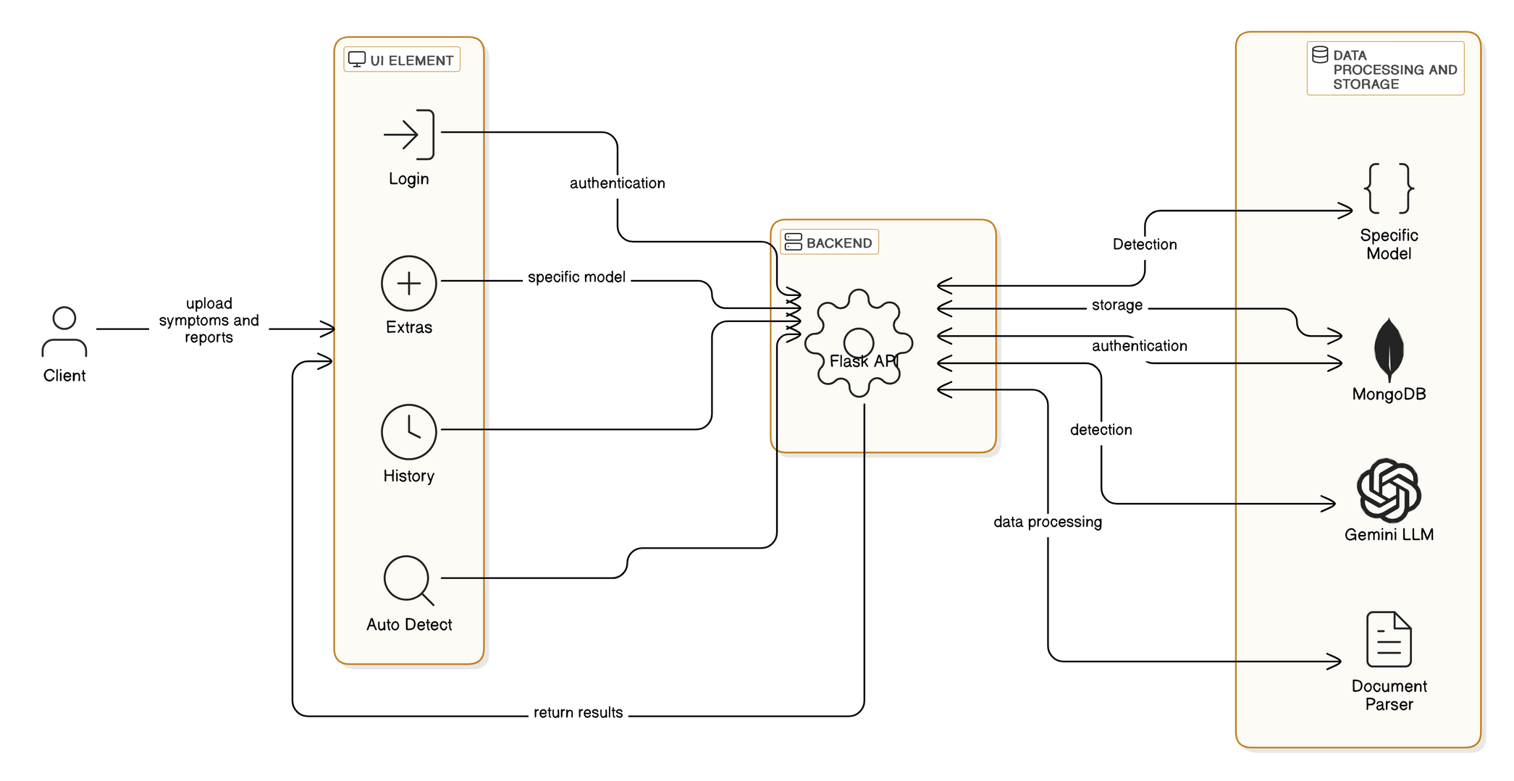
System Architecture

Slide 14


Use - Case Diagram
User Login
Database
Report Analysis and Summary
User
Specific Disease Detection
ML Model
User Report History

Slide 15
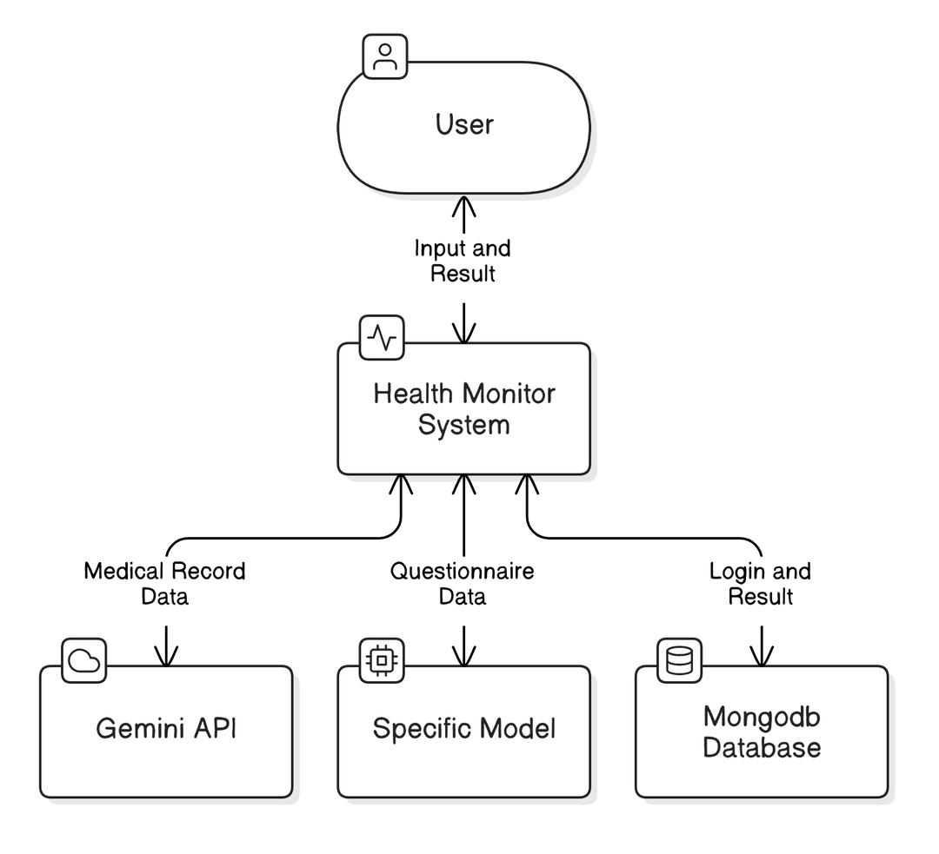
Data Flow(Level 0)

Slide 16
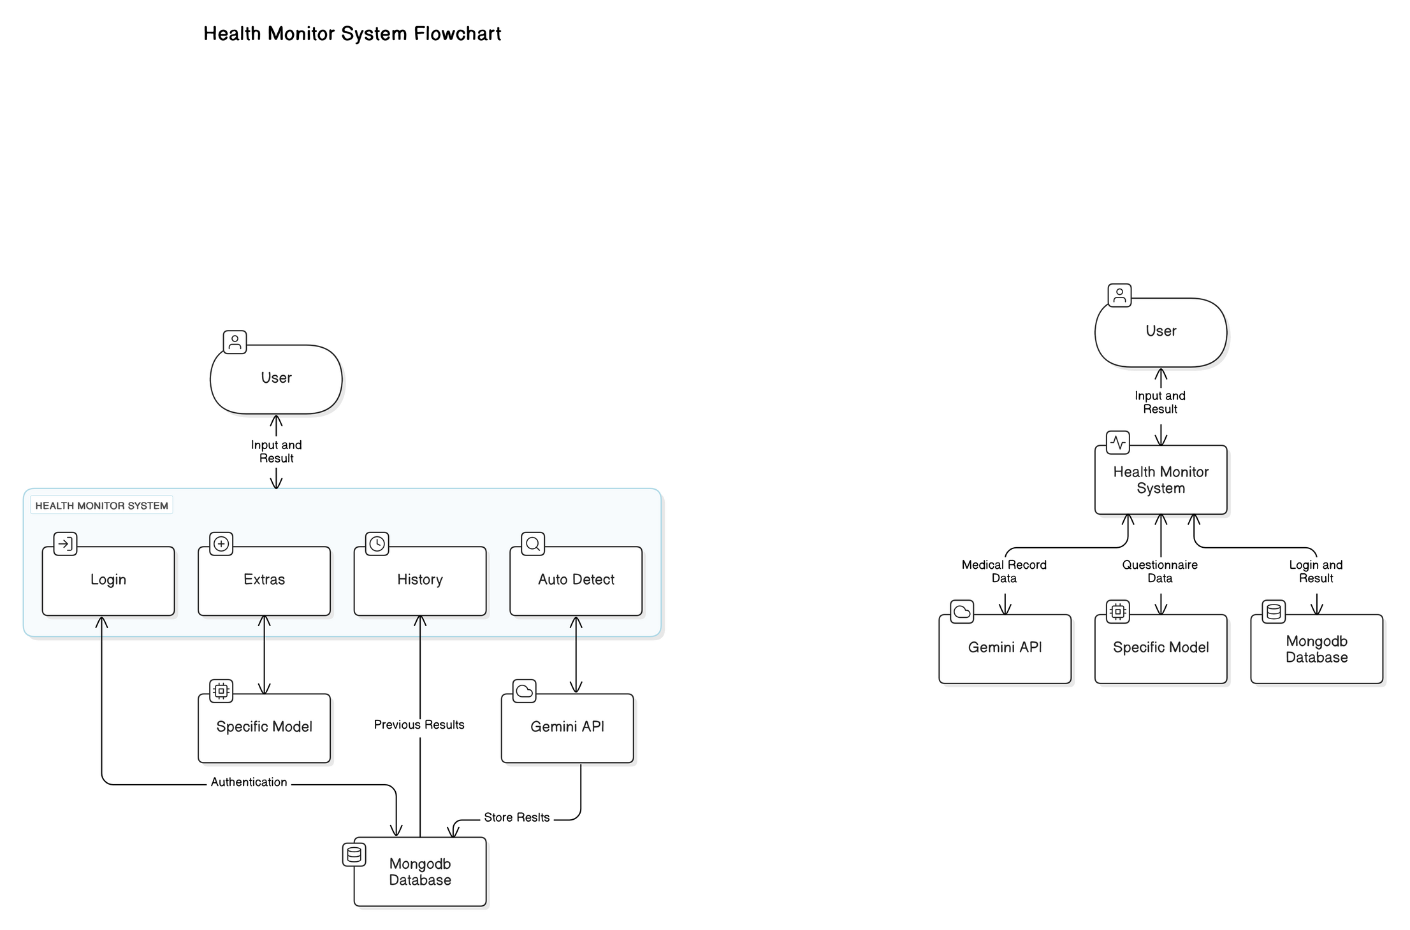
Data Flow(Level 1)

Slide 17
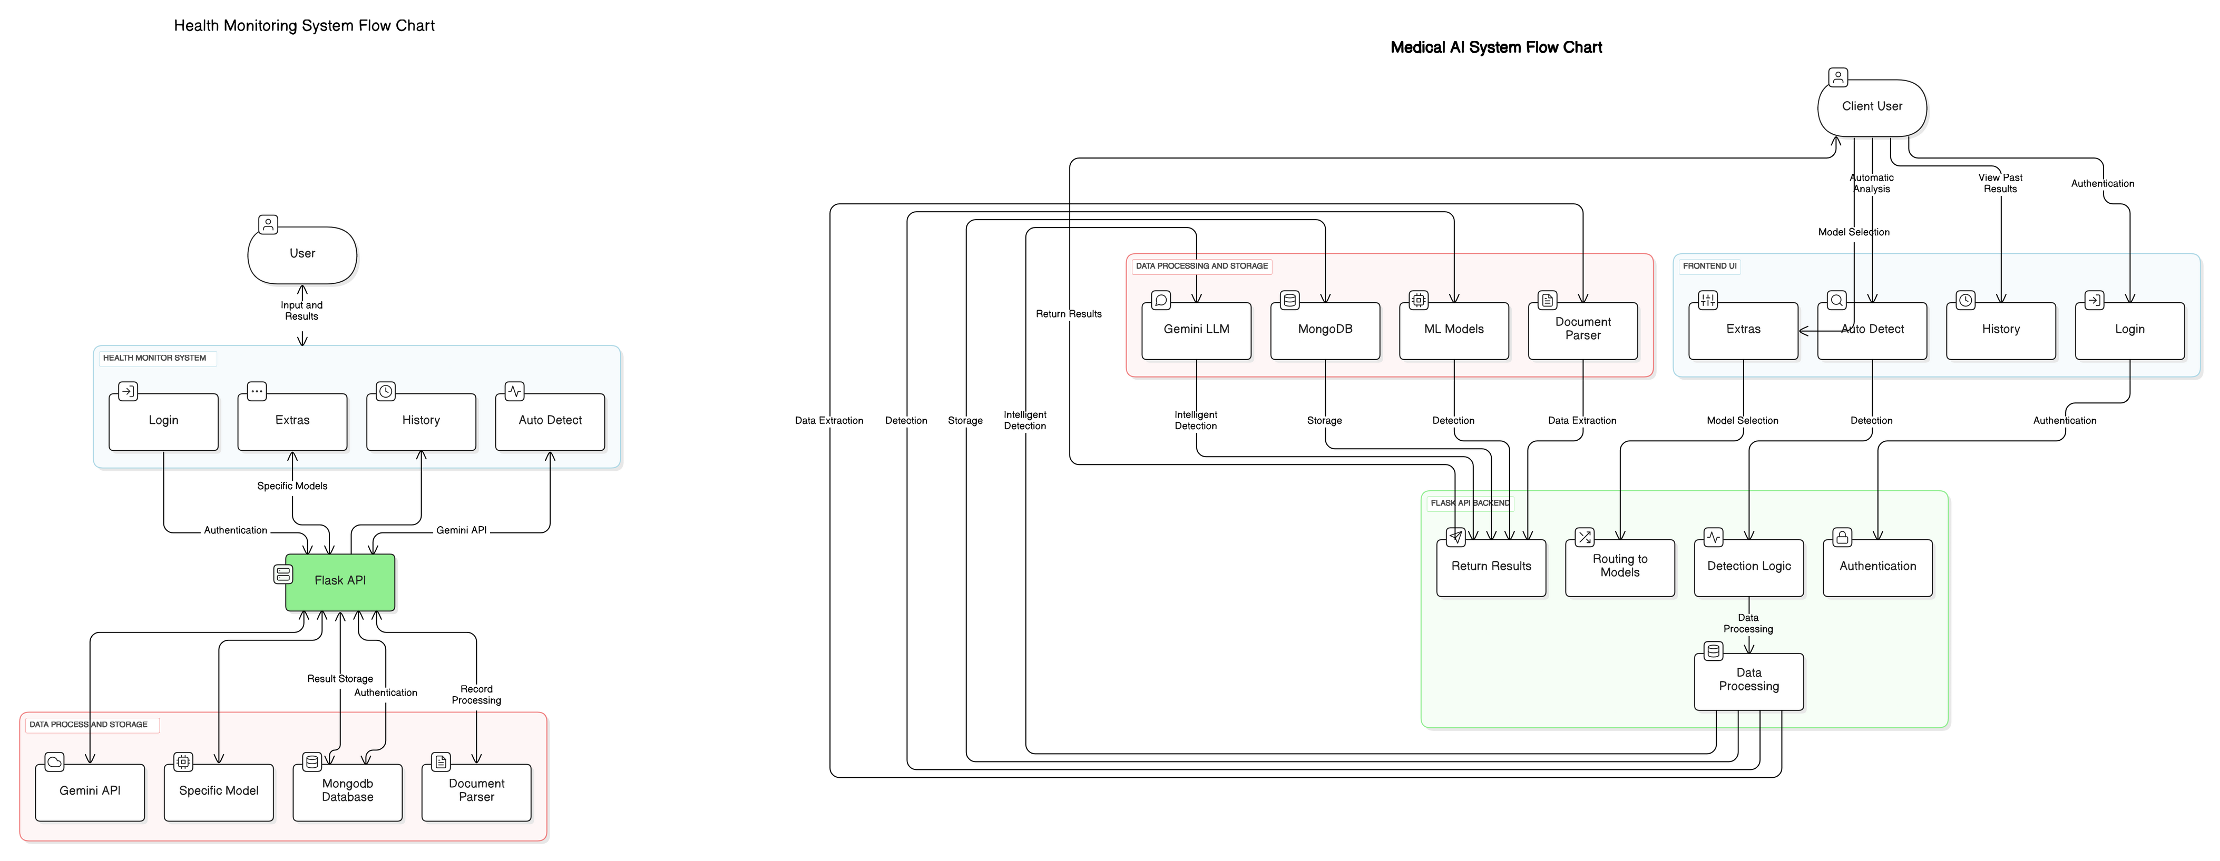
Data Flow(Level 2)

Slide 18
Hardware Requirements
For Development
For End Users
Processor: A modern multi-core CPU (e.g.,Intel i5/i7 or AMD Ryzen 5/7)
Memory: At least 8 GB of RAM
Storage: A minimum of 256 GB SSD to store datasets, code, and model artifacts.
GPU: Not required for simple models like logistic regression.
Networking: Reliable internet connection.
Processor: Any modern processor capable of running a web browser efficiently.
Memory: At least 4 GB of RAM.
Storage: Sufficient disk space to install and run the web application.
Display: A monitor or device with a resolution of 1024x768 or higher for clear UI display.
Networking: Stable internet connection for accessing the web app and real-time predictions.

Slide 19
Software Requirements
For Developers
For End Users
Operating System: Windows, macOS, or Linux.
Programming Language: Python
IDE/Code Editor: VS Code, PyCharm etc.
Libraries and Frameworks:
Flask for backend development.
scikit-learn for model training and prediction.
Pandas for data manipulation.
PyPDF2 and python-docx for document parsing.
Additional libraries: NumPy, SimpleImputer (from scikit-learn), etc.
Database: Cloud MongoDB service.
Version Control: Git for code management.
Web Technologies: HTML, CSS, and JavaScript for frontend development.
Web Browser: A modern browser (e.g., Chrome, Firefox, Edge, or Safari) with JavaScript enabled.
Operating System: Any OS that supports a modern web browser (Windows, macOS, Linux, iOS, Android).

Slide 20
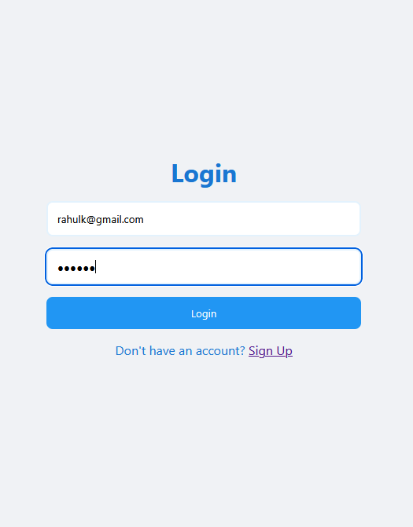
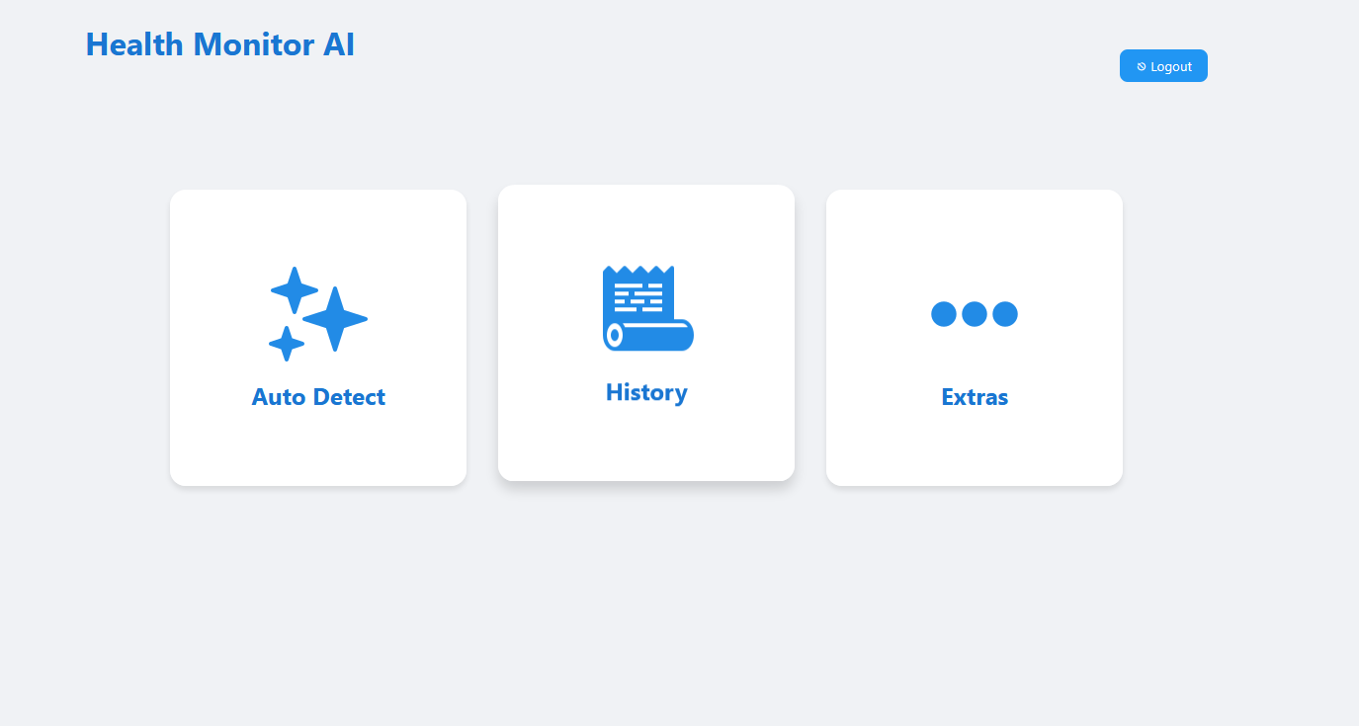
Implementation / Results

Slide 21
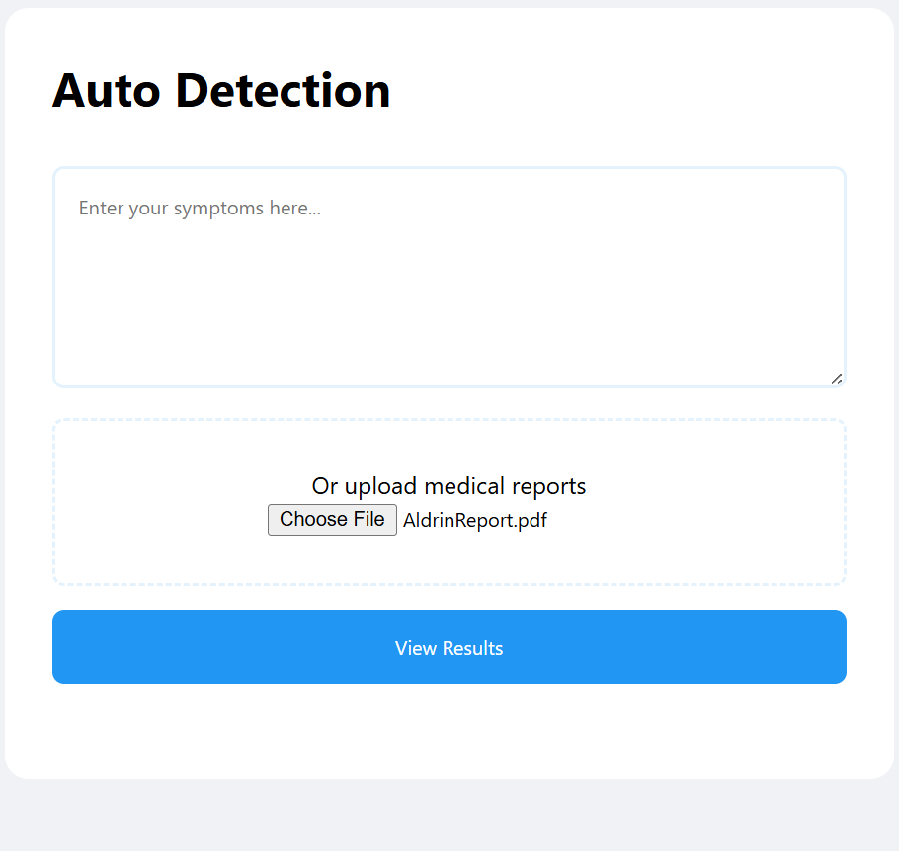
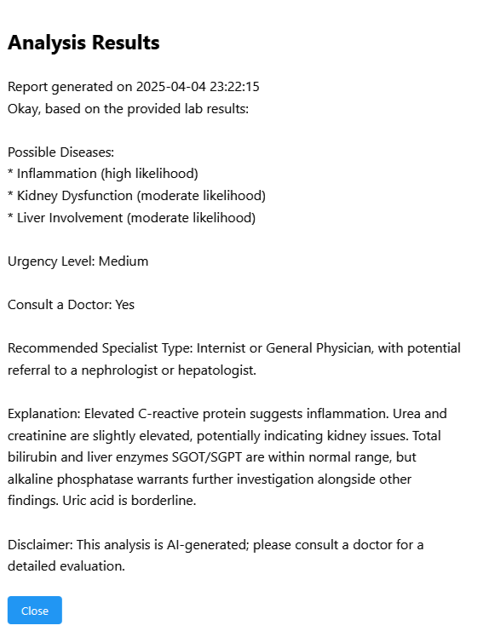

Slide 22
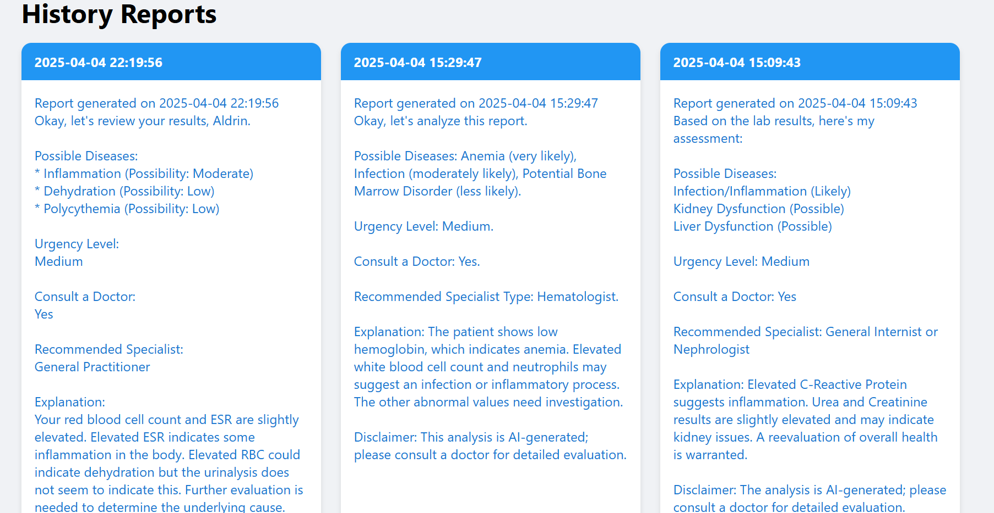

Slide 23
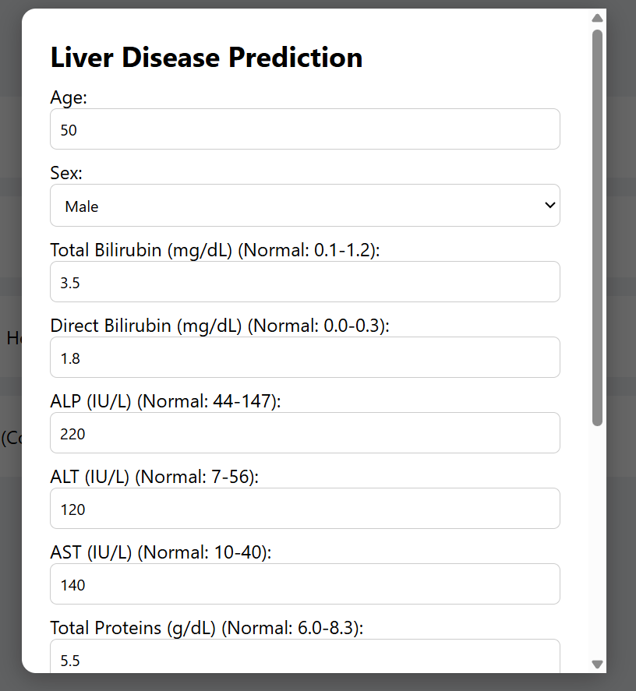
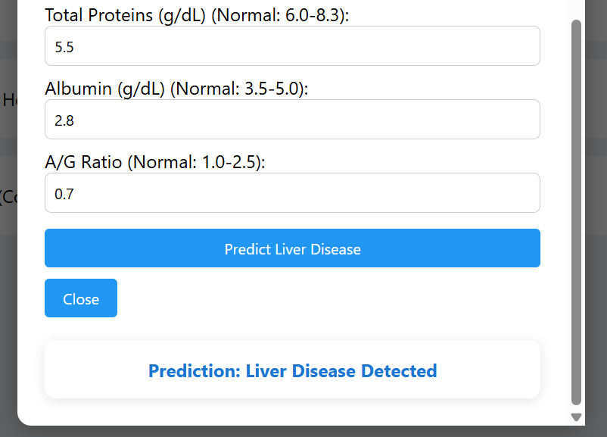

Slide 24
Conclusion
Developed an AI-powered medical platform with a user-friendly interface.
Allows input of key patient data like symptoms and test results.
Uses trusted medical sources to analyze and predict conditions accurately.
Presents results clearly with risk levels and recommendations.
Tested for reliability against expert medical opinions.
Supports better patient care through quick, data-driven insights.

Slide 25
References
World Health Organization (2021). Health systems strengthening: Challenges and opportunities.
Smith, J. and Johnson, P. (2022) The Impact of AI on Medical Data Analysis: A Case Study of IBM Watson Health. Journal of Health Informatics, 45, 145-156.
Healthcare (Basel). 2022 Mar 15;10(3):541. Machine-Learning-Based Disease Diagnosis: A Comprehensive Review
UC Irvine Machine Learning Repository.
Health-LLM: Personalized Retrieval-Augmented Disease Prediction System by Mingyu Jin, Qinkai Yu
Gemini API Documentation
Mongodb Documentation
Flask Documentation
Scikit-learn Documentation

Slide 26
Thank You

